Slide 1
Analyzing H1b visa data using Hadoop
Presented by:
Rahul Sihag
S.ID: S181107200294
NIIT Gurgaon, Haryana

Slide 2
Objective
Identify the growth cycle is increasing or decreasing.
Which industry has granted how much visa’s etc.

Slide 3
Facts Analyzed
Analyzed H1B visa applicants between the years 2011-2015.
1 a) Is the number of petitions with Data Engineer job title increasing over time?
b) Find top 5 job titles who are having highest growth in applications.
2 a) Which part of the US has the most Data Engineer jobs for each year?
b) Find top 5 locations in the US who have got certified visa for each year.
3) Which industry has the most number of Data Scientist positions?
4) Which top 5 employers file the most petitions each year?
5) Find the most popular top 10 job positions for H1B visa applications for each year?

Slide 4
Facts Analyzed
6) Find the most popular top 10 job positions for H1B visa applications for each year only for certified applications?
7) Find the percentage and the count of each case status on total applications for each year. Create a graph depicting the pattern of All the cases over the period of time.
8) Create a bar graph to depict the number of applications for each year.
9) Find the average Prevailing Wage for each Job for each Year (take part time and full time separate) arrange output in descending order.
10) Which are the employers who have the success rate in petitions more than 70% and total petitions filed more than 1000?
11) Which are the positions which have the success rate more than 70% in petitions and total petitions filed more than 1000?
12) Export result for option no 11 to MySQL database.

Slide 5
Technology used
HIVE : a data warehousing and SQL like query language that presents the data in the form of tables. Hive programming is similar to data Warehousing.
PIG: a platform for manipulating data stored in HDFS and that includes a compiler for map reduce programs and high level language called Pig Latin. It provides a way to perform data extractions, transformation and loading and basic analysis without having to write Map Reduce programs.
SQOOP : a connection and transfer mechanism that moves the data between hadoop and relational databases

Slide 6
Big Data
Big data is data sets that are so voluminous and complex.
Contains both structured(Relational), semi structured(XML,JSON) and unstructured data(Word, PDF, Text and media logs ).
When “BIG DATA” emerged as a problem, Apache HADOOP evolved as a solution to it.

Slide 7
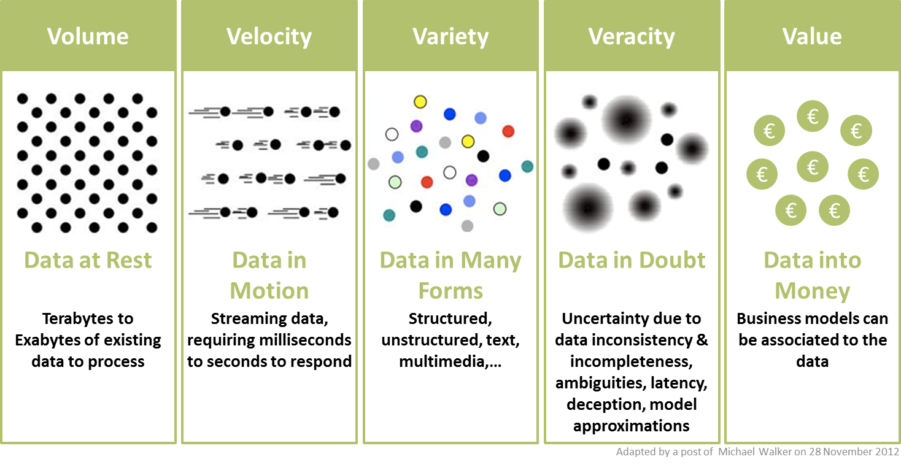
5 V’s of Big Data

Slide 8

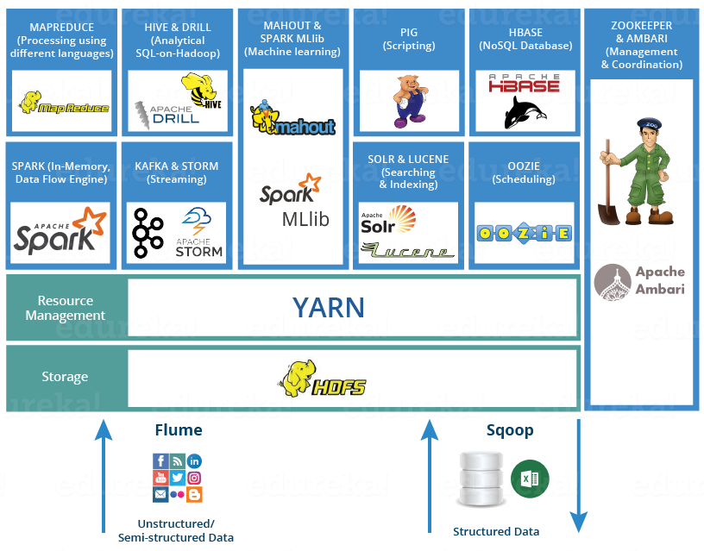
Ecosystem
Notes:
HDFS: Hadoop Distributed File System is the core component or you can say, the backbone of Hadoop Ecosystem.
YARN: Consider YARN as the brain of your Hadoop Ecosystem. It performs all your processing activities by allocating resources and scheduling tasks. It receives the processing requests, and then passes the parts of requests to corresponding NodeManagers accordingly, where the actual processing takes place.
MapReduce: is a software framework which helps in writing applications that processes large data sets using distributed and parallel algorithms inside Hadoop environment. In a MapReduce program, Map() and Reduce() are two functions.
The Map function performs actions like filtering, grouping and sorting.
While Reduce function aggregates and summarizes the result produced by map function.
SPARK: Apache Spark is a framework for real time data analytics in a distributed computing environment.
PIG: As everyone does not belong from a programming background. So, Apache PIG relieves them. 10 line of pig latin = approx. 200 lines of Map-Reduce Java code.
HIVE: HIVE is a data warehousing component which performs reading, writing and managing large data sets in a distributed environment using SQL-like interface. HIVE + SQL = HQL
Hbase: is an open source, non-relational distributed database. In other words, it is a NoSQL database. It supports all types of data and that is why, it’s capable of handling anything and everything inside a Hadoop ecosystem.
Mahout provides an environment for creating machine learning applications which are scalable. So, What is machine learning?
Machine learning algorithms allow us to build self-learning machines that evolve by itself without being explicitly programmed. Based on user behavior, data patterns and past experiences it makes important future decisions. You can call it a descendant of Artificial Intelligence (AI).
Apache Drill is used to drill into any kind of data. It’s an open source application which works with distributed environment to analyze large data sets.
Zookeeper saves a lot of time by performing synchronization, configuration maintenance, grouping and naming.
Apache Oozie: Consider Apache Oozie as a clock and alarm service inside Hadoop Ecosystem. For Apache jobs, Oozie has been just like a scheduler. It schedules Hadoop jobs and binds them together as one logical work.
FLUME: The Flume is a service which helps in ingesting unstructured and semi-structured data into HDFS. It gives us a solution which is reliable and distributed and helps us incollecting, aggregating and moving large amount of data sets. It helps us to ingest online streaming data from various sources like network traffic, social media, email messages, log files etc. in HDFS.
SQOOP: Flume only ingests unstructured data or semi-structured data into HDFS.
While Sqoop can import as well as export structured data from RDBMS or Enterprise data warehouses to HDFS or vice versa.
Apache Solr and Apache Lucene are the two services which are used for searching and indexing in Hadoop Ecosystem.
Ambari is an Apache Software Foundation Project which aims at making Hadoop ecosystem more manageable.
It includes software for provisioning, managing and monitoring Apache Hadoop clusters.
Source: https://www.edureka.co/blog/hadoop-ecosystem

Slide 9

Advantages of HADOOP

Slide 10
Advantages of HADOOP
Ability to store and process huge amount of any kind of data, quickly. With data volumes and varieties constantly increasing, especially from social media and the Internet of Things (IoT), that's a key consideration.
Computing power. Hadoop's distributed computing model processes big data fast. The more computing nodes you use, the more processing power you have.
Fault tolerance. Data and application processing are protected against hardware failure. If a node goes down, jobs are automatically redirected to other nodes to make sure the distributed computing does not fail. Multiple copies of all data are stored automatically.
Flexibility. Unlike traditional relational databases, you don’t have to pre-process data before storing it. You can store as much data as you want and decide how to use it later. That includes unstructured data like text, images and videos.
Low cost. The open-source framework is free and uses commodity hardware to store large quantities of data.
Scalability. You can easily grow your system to handle more data simply by adding nodes. Little administration is required.

Slide 11
Analysing H1B Visa Using Hadoop Ecosystem
Analysis 1 a)
Is the number of petitions with Data Engineer job title increasing over time?
Technology used : HIVE

Slide 12
Analysing H1B Visa Using Hadoop Ecosystem
Analysis 1 b)
Find top 5 job titles who are having highest growth in applications.
Technology used: PIG
Output:
(SENIOR SYSTEMS ANALYST JC 60,4255.4644)
(SOFTWARE DEVELOPER 2,3480.5925)
(PROJECT MANAGER 3,3233.3335)
(SYSTEMS ANALYST JC65,2984.8809)
(MODULE LEAD,2917.112)

Slide 13
Analysing H1B Visa Using Hadoop Ecosystem
Analysis 2 a)
Which part of the US has the most Data Engineer jobs for each year?
Technology used: PIG
Output: SEATTLE, WASHINGTON 2011 20
SEATTLE, WASHINGTON 2012 30
SEATTLE, WASHINGTON 2013 46
SEATTLE, WASHINGTON 2014 45
SEATTLE, WASHINGTON 2015 61
SEATTLE, WASHINGTON 2016 128

Slide 14
Analysing H1B Visa Using Hadoop Ecosystem
Analysis 2 b)
Find top 5 locations in the US who have got certified visa for each year.
Technology used: HIVE
Sample Output: NEW YORK, NEW YORK 2011 23172
NEW YORK, NEW YORK 2012 23737
NEW YORK, NEW YORK 2013 23537
NEW YORK, NEW YORK 2014 27634
NEW YORK, NEW YORK 2015 31266
NEW YORK, NEW YORK 2016 34639

Slide 15
Analysing H1B Visa Using Hadoop Ecosystem
Analysis 3
Which industry has the most number of Data Scientist positions?
Technology used: HIVE
Sample output:
STATISTICIANS 649
COMPUTER AND INFORMATION RESEARCH SCIENTISTS 500
OPERATIONS RESEARCH ANALYSTS 426
COMPUTER AND INFORMATION RESEARCH SCIENTISTS 208
COMPUTER OCCUPATIONS, ALL OTHER 179
STATISTICIANS 152
SOFTWARE DEVELOPERS, APPLICATIONS 148
MATHEMATICIANS 147
COMPUTER SYSTEMS ANALYTS 135
OPERATIONS RESEARCH ANALYSTS 124

Slide 16
Analysing H1B Visa Using Hadoop Ecosystem
Analysis 4
Which top 5 employers file the most petitions each year?
Technology used: HIVE
Sample output:
2011 TATA CONSULTANCY SERVICES LIMITED 5416
2012 INFOSYS LIMITED 15818
2013 INFOSYS LIMITED 32223
2014 INFOSYS LIMITED 23759
2015 INFOSYS LIMITED 33245
2016 INFOSYS LIMITED 25352

Slide 17
Analysing H1B Visa Using Hadoop Ecosystem
Analysis 5
Find the most popular top 10 job positions for H1B visa applications for each year?
Technology used: HIVE
Sample output:
PROGRAMMER ANALYST 2011 31799
SOFTWARE ENGINEER 2011 12763
COMPUTER PROGRAMMER 2011 8998
SYSTEMS ANALYST 2011 8644
BUSINESS ANALYST 2011 3891
COMPUTER SYSTEMS ANALYST 2011 3698

Slide 18
Analysing H1B Visa Using Hadoop Ecosystem
Analysis 6
Find the most popular top 10 job positions for H1B visa applications for each year only for certified applications?
Technology used: HIVE
Sample output:
PROGRAMMER ANALYST 2016 47964
SOFTWARE ENGINEER 2016 25890
SOFTWARE DEVELOPER 2016 12474
SYSTEMS ANALYST 2016 10986
COMPUTER PROGRAMMER 2016 10528
BUSINESS ANALYST 2016 8175

Slide 19
Analysing H1B Visa Using Hadoop Ecosystem
Analysis 7
Find the percentage and the count of each case status on total applications for each year, Creating a graph depicting the pattern of all cases.
Technology used: PIG
Sample output:

Slide 20
Analysing H1B Visa Using Hadoop Ecosystem
Analysis 8
Create a bar graph to depict the number of applications for each year.
Technology used: HIVE
Sample output:

Slide 21
Analysing H1B Visa Using Hadoop Ecosystem
Analysis 9
Find the average Prevailing Wage for each Job for each Year (take part time and full time separate)
Technology used: PIG
Sample output: 2011
(( SYSTEMS ANALYST,Y),42078.5)
(( COMPUTER SYSTEMS ENGINEER,Y),46218.0)
(( INFORMATION MANAGEMENT SPECIALIST,Y),38875.0)
(([PHYSICAL THERAPIST,Y),69035.0)

Slide 22
Analysing H1B Visa Using Hadoop Ecosystem
Analysis 10
Which are employers who have the highest success rate in petitions more than 70% in petitions and total petitions filed more than 1000?
Technology used: PIG
Sample output:
(INFOSYS LIMITED,99.54055,130592)
(ACCENTURE LLP,99.39307,33447)
(TATA CONSULTANCY SERVICES LIMITED,99.337204,64726)
(HCL AMERICA, INC.,99.26801,22678)
(RELIABLE SOFTWARE RESOURCES, INC.,99.14658,1992)
(NTT DATA, INC.,99.13251,4611)

Slide 23
Analysing H1B Visa Using Hadoop Ecosystem
Analysis 11
Which are the positions which have the success rate more than 70% in petitions and total petitions filed more than 1000?
Technology used: PIG
Sample output:
((SYSTEMS ENGINEER - US,10036,99.90035870864887)
(TECHNOLOGY LEAD - US,28350,99.80246913580247)
(TECHNOLOGY ANALYST - US,26055,99.7620418345807)
(LEAD ENGINEER,11157,98.23429237250157)
(DEVELOPER,12909,98.00914090944302)

Slide 24
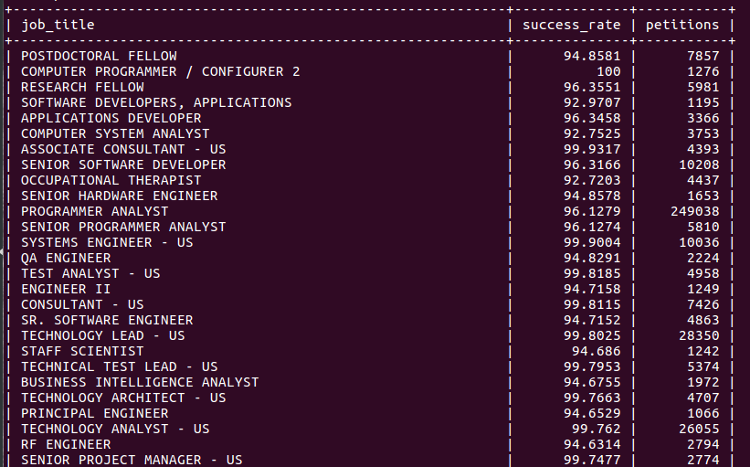
Analysing H1B Visa Using Hadoop Ecosystem
Analysis 12
Export result for question no 11 to MySQL database.
Technology used: Sqoop
Sample code:
sqoop export --connect jdbc:mysql://localhost/question11 --username root --password 'macbook' --table question11 --export-dir /Pig/Question10/ --input-fields-terminated-by '\t' ;

Slide 25
Analysing H1B Visa Using Hadoop Ecosystem
THANK YOU…

